Slide 1
Data preprocessing
Vera Hollink
2025

Slide 2

Topics last class
What is machine learning
Terminology
Machine Learning tasks
Crisp-DM
Data exploration

Slide 3

Data preprocessing

Slide 4
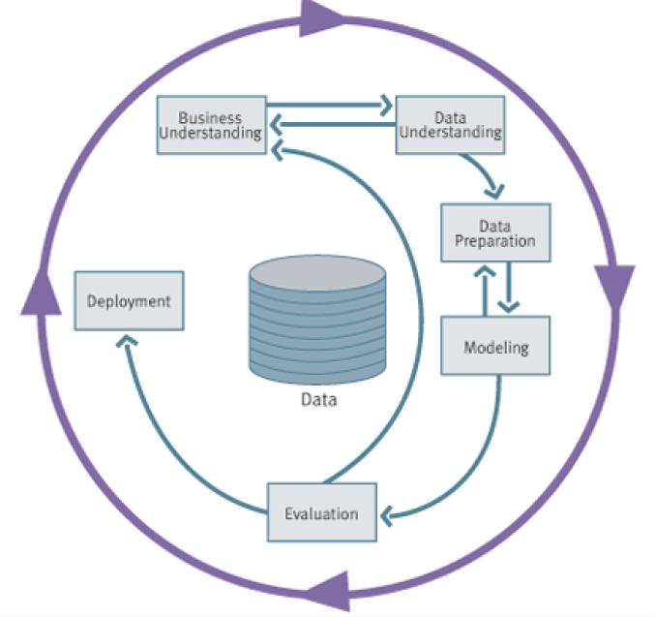
Data Mining Process: CRISP-DM
Image from “Data Science for Business”, Provost and Fawcett, 2013
Notes:
* Cross-Industry Standard Process for Data Mining (Shearer, 2000)

Slide 5
Preprocessing steps
Handling missing values
One-hot encoding
Scaling
Feature engineering

Slide 6
Preprocessing steps
Handling missing values
Label encoding
Scaling
Feature engineering

Slide 7
Missing values
Name | Color | Age | Weight
Fikki | Blue | 5
Minoes | UNKNOWN | 7 | 8
Doodles | Red | ? | 34
How are missing values represented?
How many missing values are there
for each attribute?
for each instance?

Slide 8
Handling missing values
1. Do nothing
some methods and tools can handle incomplete cases; sklearn can’t!
2. Remove the sample
Samples with many missing values
3. Remove the attribute
Attributes with many missing values
4. Encode
e.g., “unknown”, “-1”

Slide 9
Handling missing values
5. Impute
replace by global mean, median or mode
e.g. missing weight → mean weight
replace by the class mean, median or mode
e.g. classes: dog, cat, rabbit:
missing weight for a dog → mean weight for dogs
missing weight for a cat → mean weight for cats
missing weight for a rabbit → mean weight for rabbits
replace by the most probable value: create prediction model
e.g. regression model to predict weight from size

Slide 10
Preprocessing steps
Handling missing values
One-hot encoding
Scaling
Feature engineering

Slide 11
One-hot encoding: categorical ➔ numerical
Name | Species | Weight (g) | Sex
Bobo | Guinea pig | 150 | Male
Johnny | Cat | 2120 | Male
Noeshka | Cat | 1905 | Female
Pip | Dog | 1028 | Female
Many methods/libraries require numerical features
Encode ‘Species’ and ‘Sex’

Slide 12
Label encoding
Name | Species
Bobo | 0
Johnny | 1
Noeshka | 1
Pip | 2
Label encoding Species:
Guinea pig ➔ 0 Cat ➔ 1 Dog ➔ 2
Disadvantage: implied order
Use only for ordinal attributes

Slide 13
One-hot encoding
Name | Species_guinea_pig | Species_cat | Species_dog
Bobo | 1 | 0 | 0
Johnny | 0 | 1 | 0
Noeshka | 0 | 1 | 0
Pip | 0 | 0 | 1
Disadvantage: large number of features

Slide 14
One-hot encoding binary feature
Name | Sex_male | Sex_female
Bobo | 1 | 0
Johnny | 1 | 0
Noeshka | 0 | 1
Pip | 0 | 1
Name | Sex_male
Bobo | 1
Johnny | 1
Noeshka | 0
Pip | 0

Slide 15
Preprocessing steps
Handling missing values
One-hot encoding
Scaling
Feature engineering

Slide 16
Scaling (normalization)
Name | Weight (g) | Age | Speed (km/h)
Bobo | 150 | 1 | 9
Johnny | 2120 | 7 | 48
Noeshka | 1905 | 12 | 42
Pip | 1028 | 6 | 28
Numerical features on different scales
Largest feature has most influence
Bring features on the same scale

Slide 17
Min-max normalization
Fix range
Bring values of each variable between fixed minimum and maximum
Range [0:1]:
Range [new_min_{A}, new_max_{A}]

Slide 18
Z-score normalization
Feature follows a normal distribution
mean μ_{A}
standard deviation σ_{A}
Standardize mean and standard deviation of each feature
new mean 0
new standard deviation 1

Slide 19
Preprocessing steps
Handling missing values
One-hot encoding
Scaling
Feature engineering

Slide 20
Feature engineering
Predict rental price of a room
Features: room length, room width
Important: room area
➔ new feature: area = length * width
Polynomial transformation
Original features: a and b
New features: a, b, ab, a², b²

Slide 21
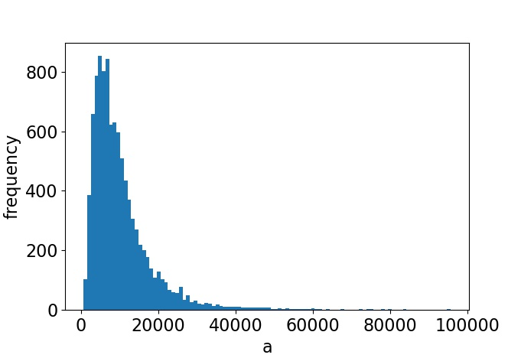
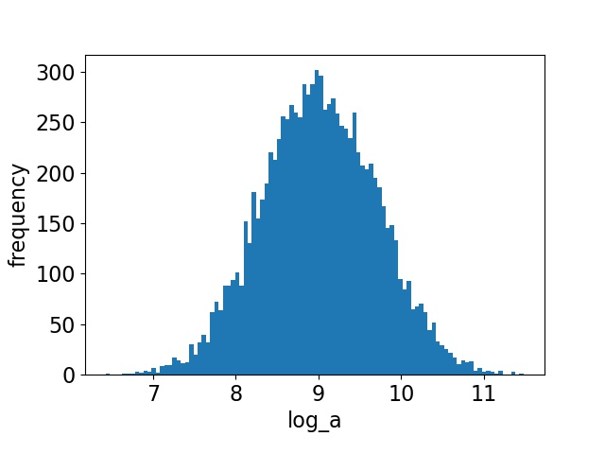
Feature engineering: to normal distribution
Logarithmic transformation
Original feature: a
New feature: log(a)

Slide 22
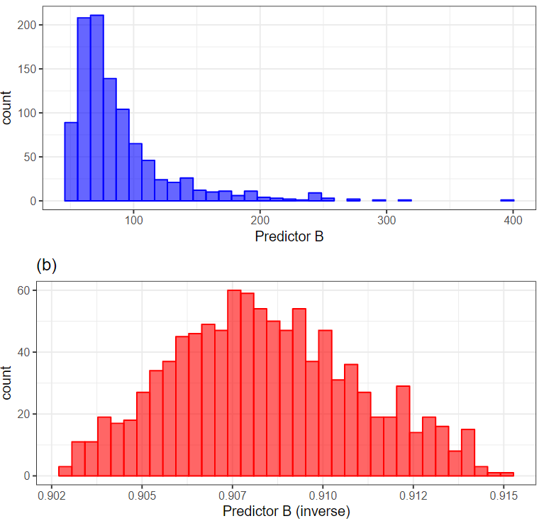

Feature engineering: to normal distribution
Box-Cox transformation
Original feature: y
New feature:
Find λ that makes distribution most normal

Slide 23
Discretization: Binning
Replace value by bin mean of median
E.g. 1-5, 5-10, 10-15
Equal-width (distance) partitioning
N intervals of equal size
Equal-depth (frequency) partitioning
N intervals, each containing approximately same number of samples

Slide 24

Machine Learning in Python

Slide 25
Some preprocessing with sklearn
Demo script Exploration_preprocessing.py

Slide 26
And now…
Assign data sets for assignments
Exercises part 1:
Getting started
Data exploration
Data preprocessing

Slide 27
 | Data set | Predict | Samples | Features
1 | songs on Spotify | popularity | 2,000 | 18
2 | real estate listings | house price | 203,126 | 12
3 | backgrounds of students | dropout | 4,424 | 37
4 | passenger and flight data | satisfaction | 129,879 | 24
5 | credit card transactions | fraud | 1,000,000 | 8
6 | online payments | fraud | 10,485,574 | 10
7 | soccer player data | release clause amount | 18,207 | 89
8 | patient data | thyroid disease type | 9,172 | 31
9 | measurements on marine snails | age | 4,177 | 9
10 | magic cards | rarity | 162,279 | 39
11 | Online news popularity | number of shares | 39,797 | 61

